Slide 1
Akiyoshidai Quasi-National Park

Slide 2
Location and basic information
Akiyoshidai Quasi-National Park is located in Yamaguchi Prefecture, Japan. It was founded on 1 November 1955 and has an area of 45.02km². It consists of two main parts Akiyoshidai plateau which is 130 square kilometere area of karst topography as well as over 400 limestone caves, including Japan's longest cave Akiyoshidai cave which is 8.9 kilometere long.

Slide 3
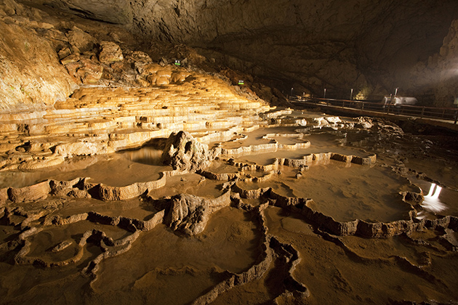
Akiyoshidai cave

Slide 4
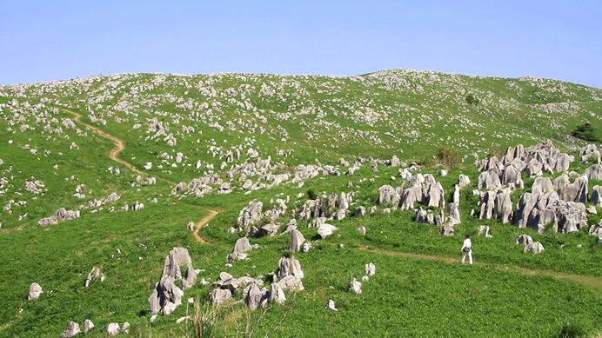
Akiyoshidai plateau

Slide 5
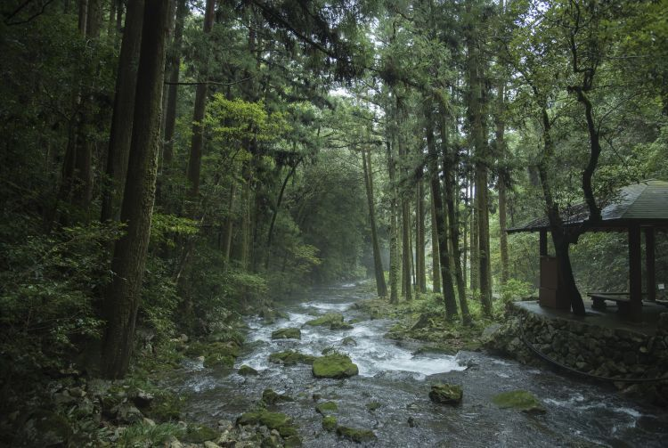

Slide 6
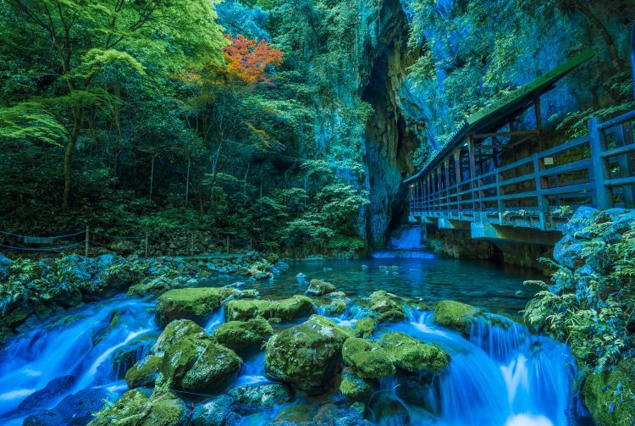

Slide 7
Geology
The plateau consists of uplifted reef limestones from the Paleozoic era, which were thickened by overfolding during the Akiyoshidai orogenic movement. Subsequent erosion has created an undulating karst landscape dimpled with many dolines and countless limestone pinnacles up to two meters in height. Beneath the surface lie hundreds of caves, a few of them quite significant geologically. The area around Akiyoshidai was heavily forested about 500,000 years ago, the bottom sinkholes were used as vegetable fields. As farming started in Japan the local people eventually entirely replaced the forested landscape with Japanese pampas grass for feeding their animals and thatching houses. Repeated cycles of burning the grass have kept trees from growing back since.

Slide 8
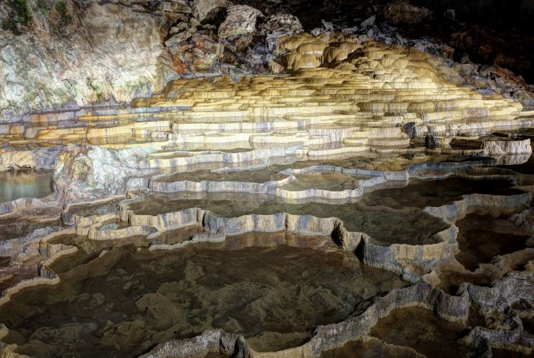

Slide 9
Fun facts
fossils of Pleistocene age have been found in these caves, including those of the Japanese rhinoceros, Stegodont elephant, Naumann elephant, Young tiger, and many other animals from the last interglacial period
In the Jōmon period this area served as a hunting ground
Akiyoshidō cave was named by Emperor Hirohito on May 30, 1926 when he was crown prince of Japan
350 million years ago this whole area including plateau was underwater

